Slide 1
NY District Circle K Presents…
Recruitment
Tabling Tips & Tricks

Slide 2
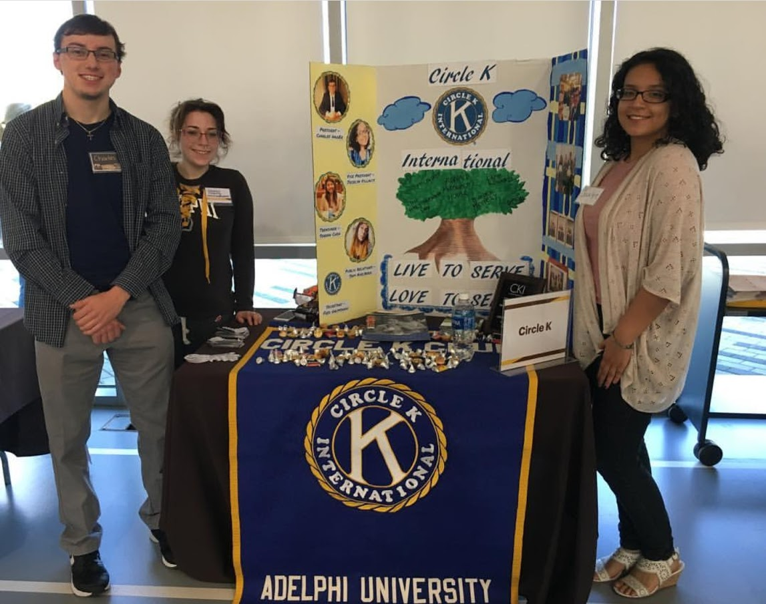
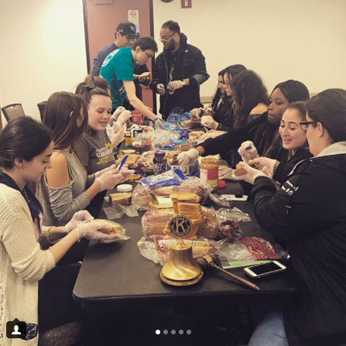
What is Recruitment & Retention?
Recruitment
Gaining NEW members
Best time to recruit is the first few weeks BEFORE & AFTER the start of the semester
Retention
Retaining the members you ALREADY have
By the activities you do throughout the year

Slide 3
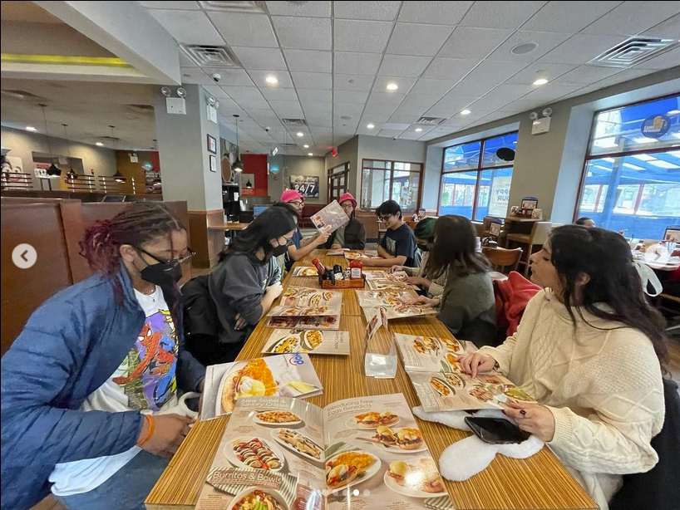
Retention
The key to keeping a club alive and strong
Foster an atmosphere that members what to be apart of
Club Meetings
Social Activities
Keep members interested
Do a variety of activities
Listen to member feedback
Recognize members

Slide 4
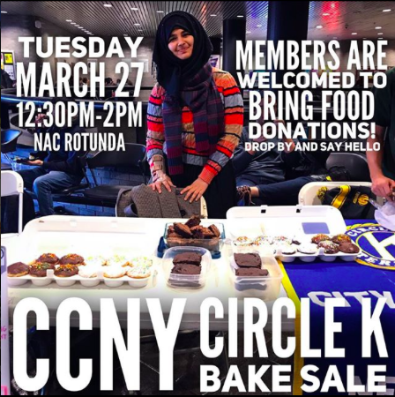
Recruitment
The key to starting and growing a club
Be proactive & approachable at events
Table to attract other & encourage visitors
Advertise yourself at other events
Get the word out
Collaborate on campus with other orgs
Have a presence on campus

Slide 5
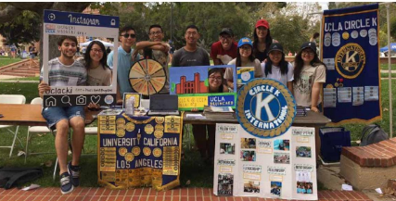

Slide 6
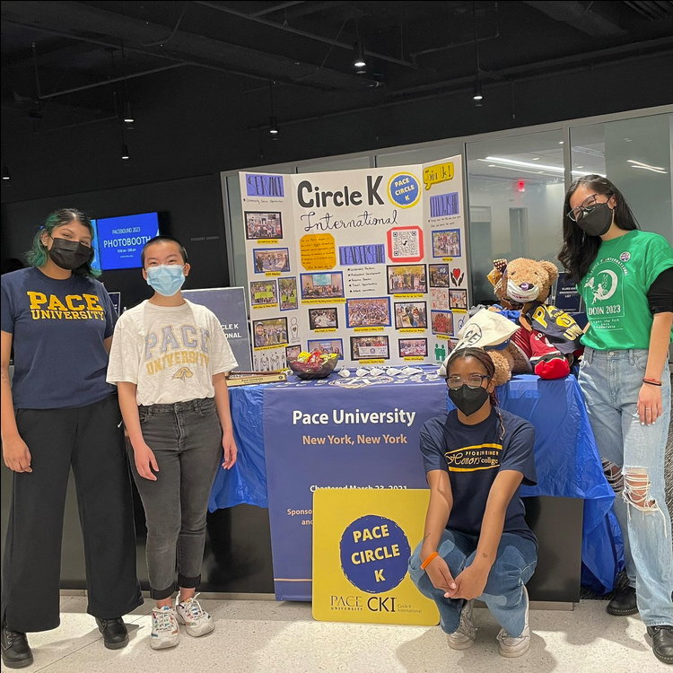
Pace
What is Tabling?
Recruitment tactic
Used to attract new members to the club
Usually Freshman
Set up a table
Displays who your club is and what you do
Have a variety of elements at the table to attract people to the table and to the club
Members also pitch the club

Slide 7
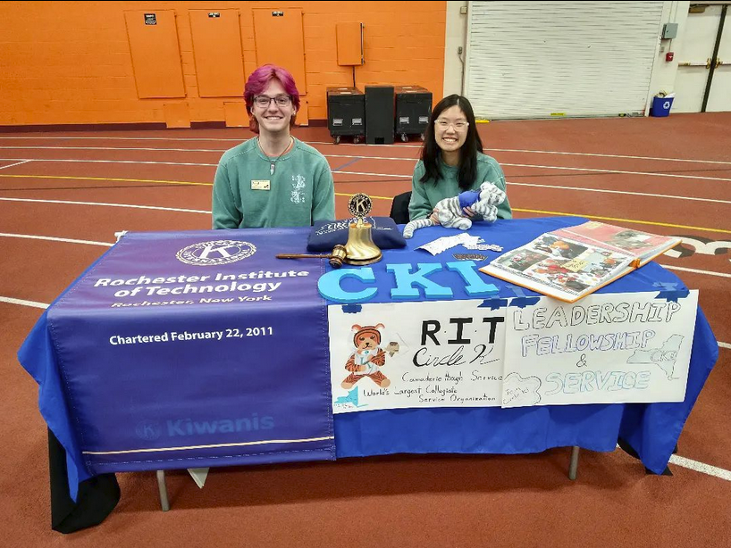
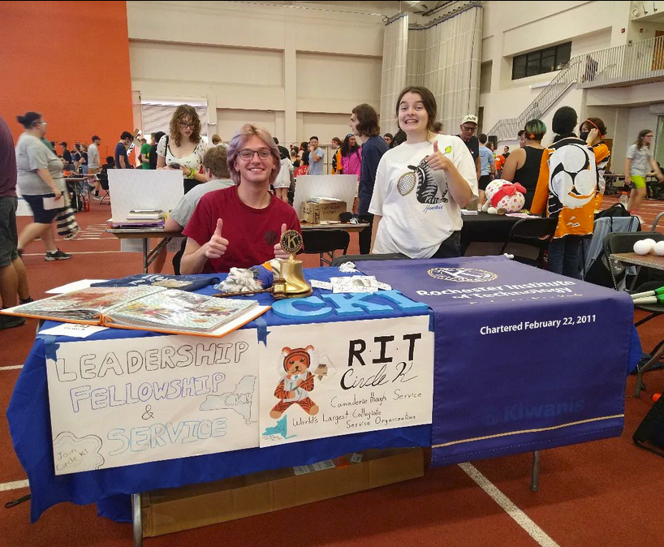
RIT
Where to Table?
Club Fairs
Fall AND Spring
Community service fairs
On campus club activities
On campus service events
Open to all students
Randomly throughout the Semester
It doesn’t have to be a club fair!

Slide 8
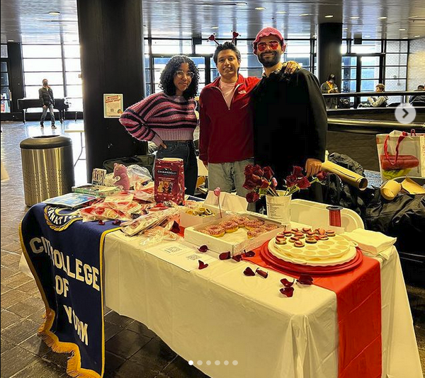
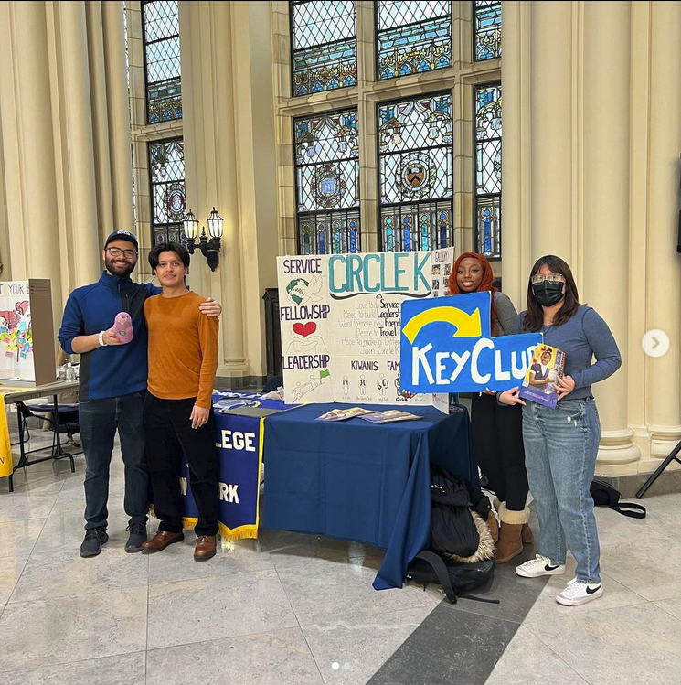
CCNY
When not to Table
NEVER!
Table anywhere!
Fundraisers
Food Drives
Advocacy
Public Service Events
Any event on campus
Just ‘cus

Slide 9
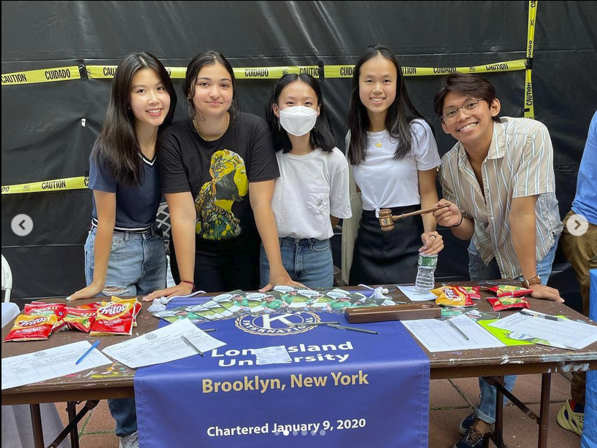
LIU Brooklyn
How to prepare
Prepare and Practice and elevator speech
Create a signup schedule
Get members excited & eager to visit
Get members to create posters!
Post on social media!
What are you giving out?
Where are you?

Slide 10
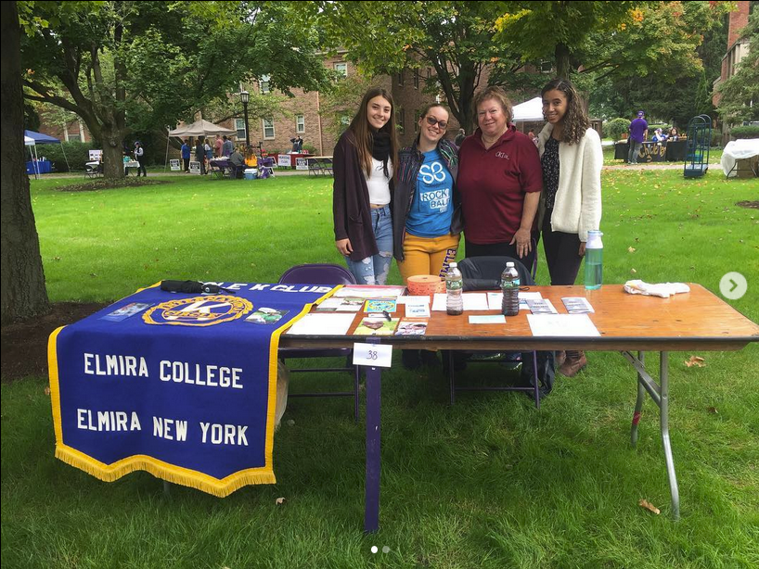
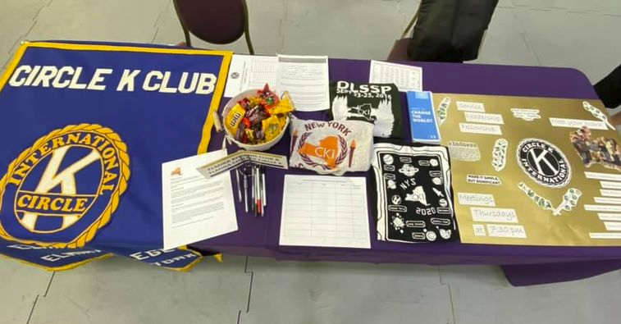
Elmira
What to say
BRAINSTORM!!

Slide 11
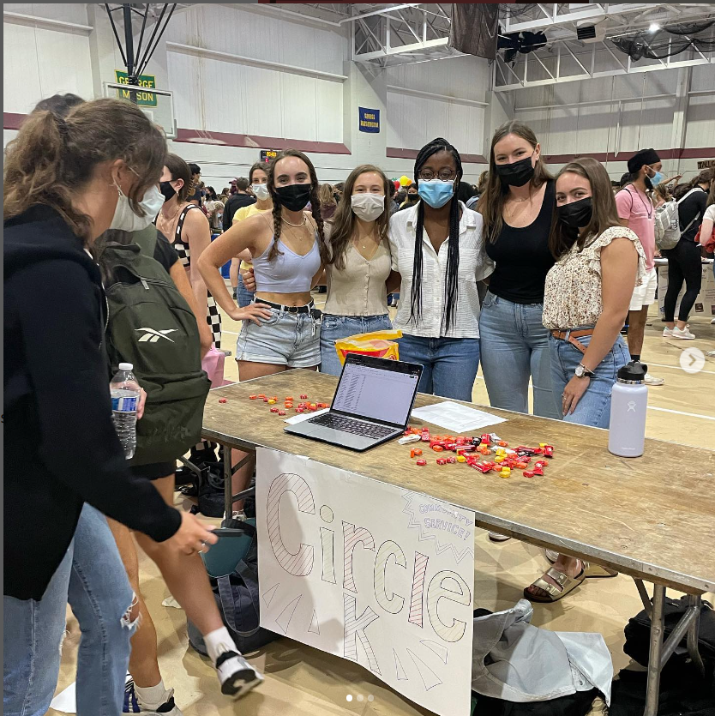
Fordham
What to say
Why did you join CKI?
Why did you stay?
What makes CKI unique?
K-Family, District, International
What will your club be doing?
Where will you visit?
How will it benefit them professional?
Ask them questions!!

Slide 12
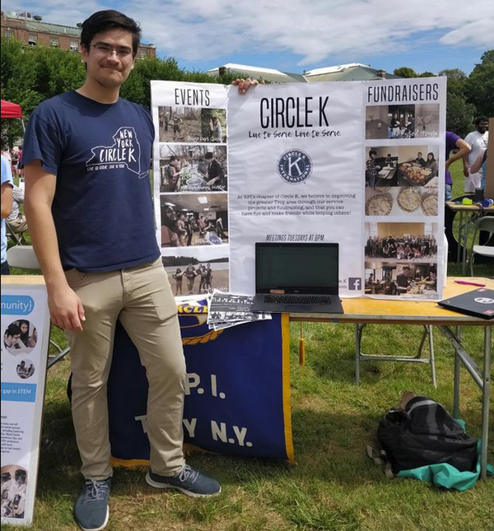
RPI
Key things to have
Advertise to past Key’ers
“Key Clubbers wanted!”
Have the CKI seal somewhere
Pictures!!
Give evidence of what you do!
An interest sheet
Computer or physical form?
Ensure they fill it out!!
Make it clear at a glance who you are & what you do
Buzz words that people know
CKI Merch!

Slide 13
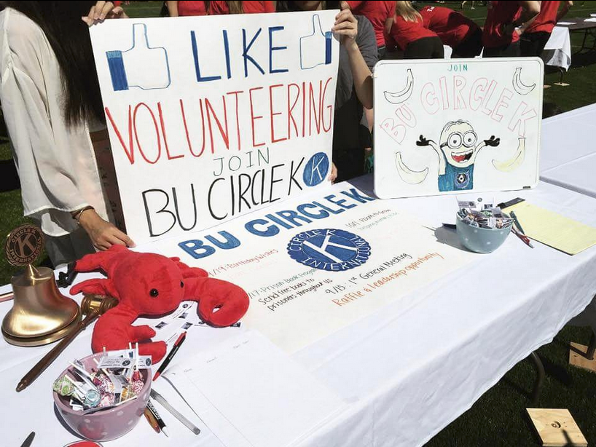
Boston Uni.
Key things to do
Stand!
Actively invite people over
Don’t just sit there
Be engaging!
Try to engage in conversation
Don’t just speak at them
Name tag with position?
What does CKI have to offer?
Have fun!

Slide 14
Adelphi
Make it interactive
Do a service project!
Have a positivity board
Simple craft service
Giveaways!
Activities for prizes!
Spin a wheel, Plinko, etc
Random Trivia
Guess amount of jelly beans in a jar (with prize at the meeting!)
Food
Have unique food if possible
Popcorn machine, water ice

Slide 15
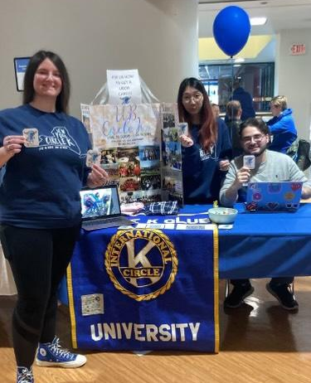
UB
What to give away
What will people want?
Stickers
Food (Ramen, Baked Goods, etc)
Candy (The good stuff)
College specific things (Map with the best ____ spots)
Positivity Rocks?
Plants
Raffles!
Attach your information to everything!!
Stickers
Buisness Cards
QR codes
Flyers

Slide 16
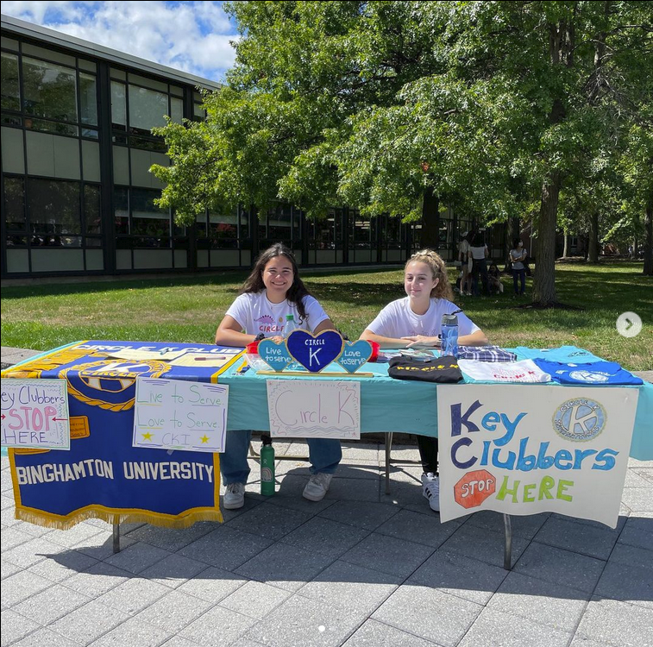
Binghamton
How to get them to a meeting?
Follow up with those on the interest form
FOOD!!!
Not Pizza (Over done)
Raffles
Get a ticket at the fair and are entered if they bring it to the meeting
Or raffle for all in meeting attendance

Slide 17
More Resources
Preparation Questions
Interacting with Interested Students
Recruitment & Retention Workshop
Recruitment & Retention Workshop 2

